Slide 1
3rd EPCAC Meeting: Part 6: What lessons can be learned from emission reductions during corona lockdown? The effects of lockdown measures on air quality in Italy based on model simulations
Ilaria D’Elia and Massimo D’Isidoro (ENEA)
3rd EPCAC meeting – 29 November 2021

Slide 2
The Project PULVIRUS
Scientific alliance between ENEA, the Italian National Institute of Health (ISS) and the National System for Environmental Protection (ISPRA+SNPA), to investigate the debated link between air pollution and the spread of the pandemic, the physical-chemical-biological interactions between fine particulate matter and viruses, the effects of the "lockdown" on air pollution and greenhouse gases in Italy;
Start 24 June 2020 to 23 June 2022;
6 Working Packages:
WP1: Analysis of the effects of physical distancing measures during the period of the COVID 19 pandemic: what the Italian monitoring stations say;
WP2: The effects of lockdown measures on air quality in Italy based on model simulations;
WP3: Characterization of the particulate matter chemical composition and size distribution;
WP4: Effect of the COVID related emission reductions on greenhouse gases;
WP5: Physical-chemical-biological interactions between fine particles and viruses;
WP6: Recommendations on air particulate samples treatment, preliminary evaluations for the development of an early warning model and training in the emergency context.
More information available at https://www.pulvirus.it/ (in Italian but it will be soon translated in English).

Slide 3
The Project PULVIRUS
Scientific alliance between ENEA, the Italian National Institute of Health (ISS) and the National System for Environmental Protection (ISPRA+SNPA), to investigate the debated link between air pollution and the spread of the pandemic, the physical-chemical-biological interactions between fine particulate matter and viruses, the effects of the "lockdown" on air pollution and greenhouse gases in Italy;
Start 24 June 2020 to 23 June 2022;
6 Working Packages:
WP1: Analysis of the effects of physical distancing measures during the period of the COVID 19 pandemic: what the Italian monitoring stations say;
WP2: The effects of lockdown measures on air quality in Italy based on model simulations;
WP3: Characterization of the particulate matter chemical composition and size distribution;
WP4: Effect of the COVID related emission reductions on greenhouse gases;
WP5: Physical-chemical-biological interactions between fine particles and viruses;
WP6: Recommendations on air particulate samples treatment, preliminary evaluations for the development of an early warning model and training in the emergency context.
More information available at https://www.pulvirus.it/ (in Italian but it will be soon translated in English).

Slide 4
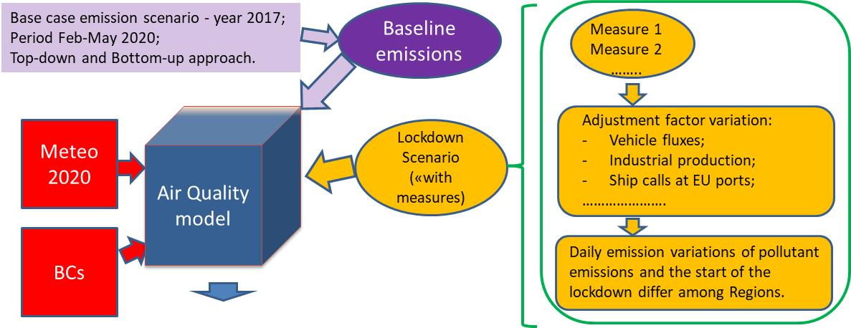
The effects of lockdown measures on air quality in Italy:
the methodology
The aim of the project is to understand
how air quality models reproduce significant emission variations in a very short period;
the emission variations from specific sectors affected by the COVID-19 restrictions;
the effect on secondary pollutants.
MINNI model (ENEA): 4km resolution (national simulation) SNPA-ASI (ArpaE): 7 km resolution (national simulation)

Slide 5
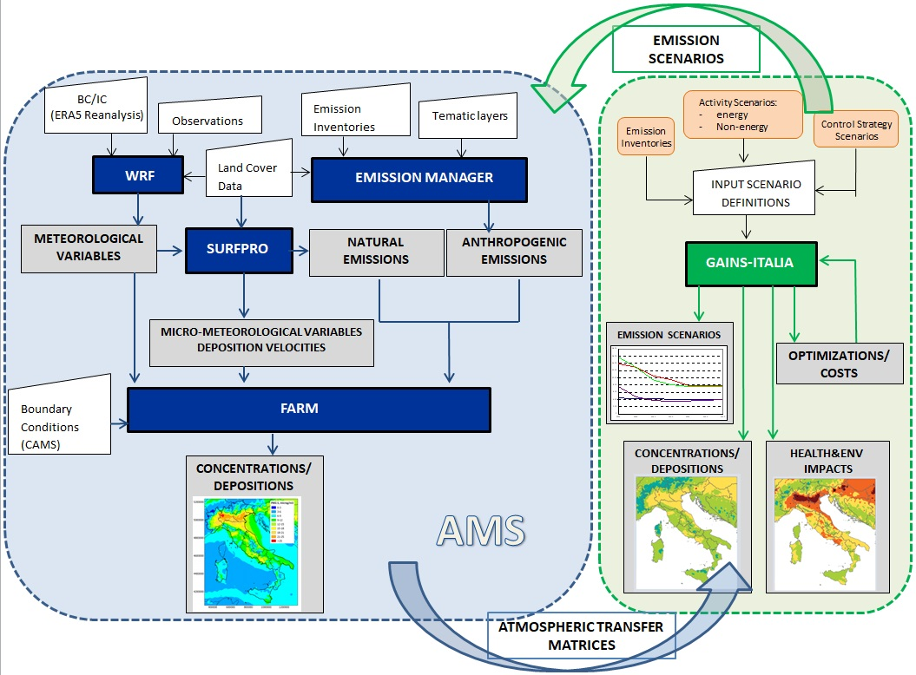
The MINNI model setup
Two air quality simulations: BASE and LOCK;
Period: 1 February – 31 May 2020;
MINNI model: 4km resolution;
MINNI model:
BC from CAMS Covid Simulation base and lockdown (MINNI_CAMS details:
Emissions -> CAMS_REG_APv4.2 – year 2017;
meteo IFS;
base and lockdown scenario with lockdown starting the 21st of February 2020).
Meteo: WRF (year 2020), two-way nesting (12km -> 4km) and ERA5 as BC;
BVOC: MEGAN model.

Slide 6
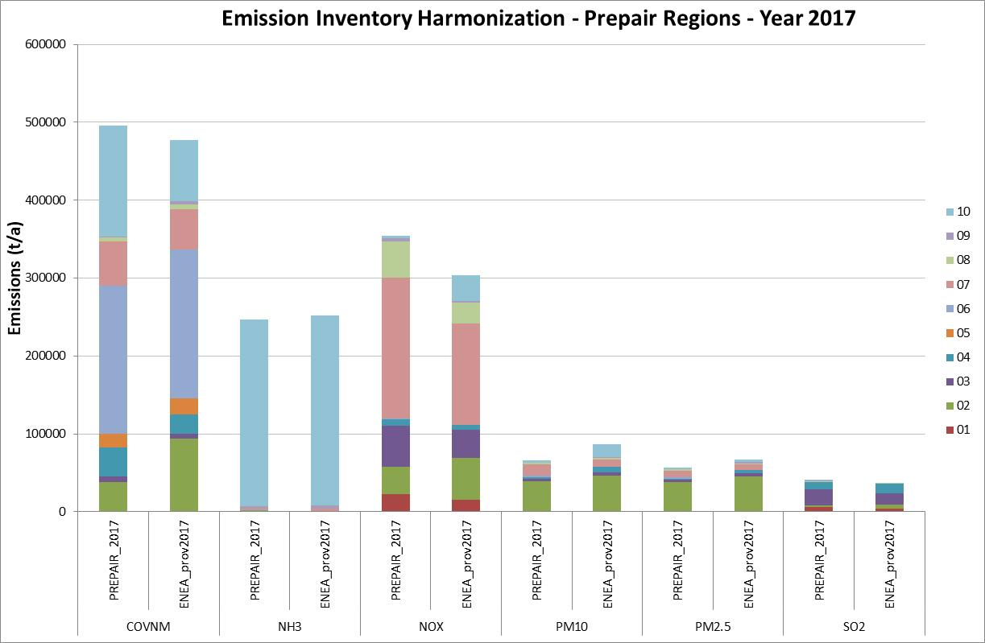
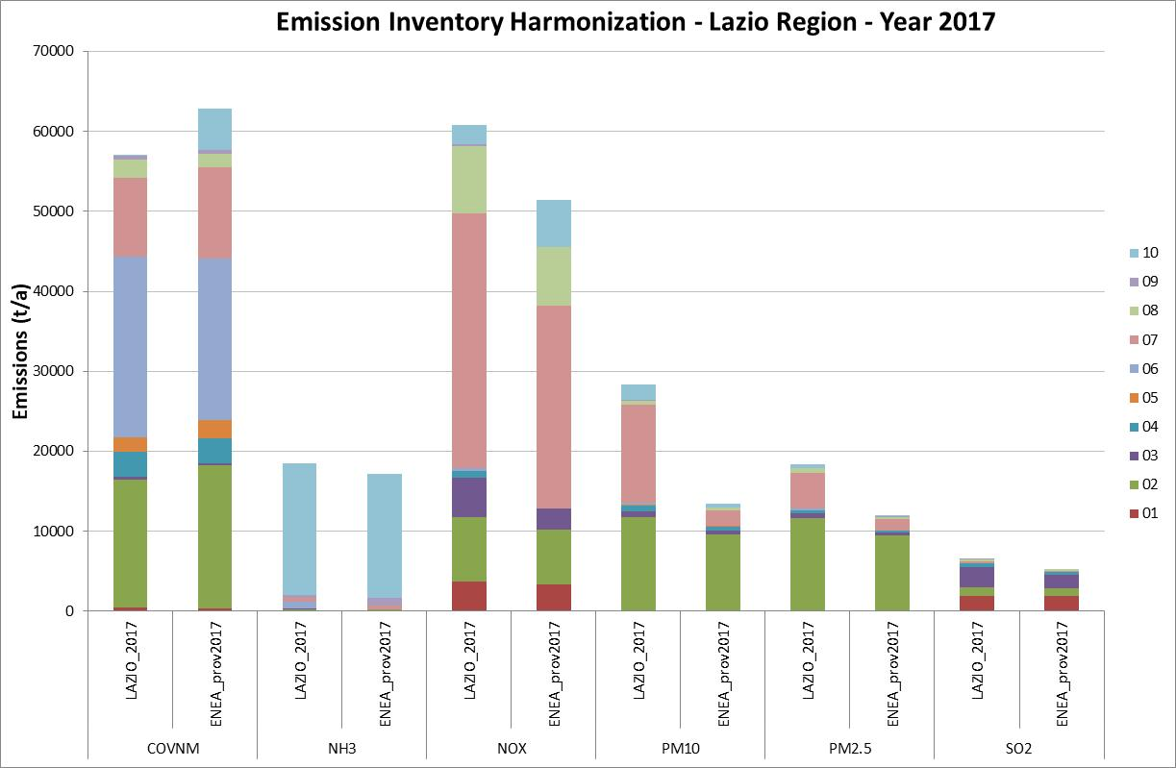
The base case emission scenario
Base case emission scenario - year 2017
Harmonization with the available regional emission inventories

Slide 7
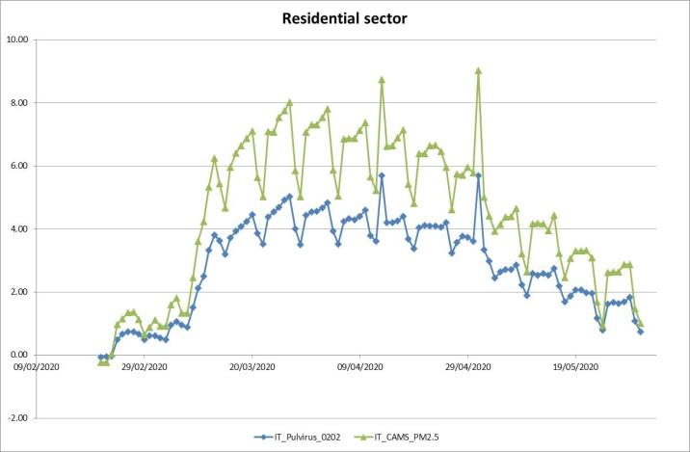
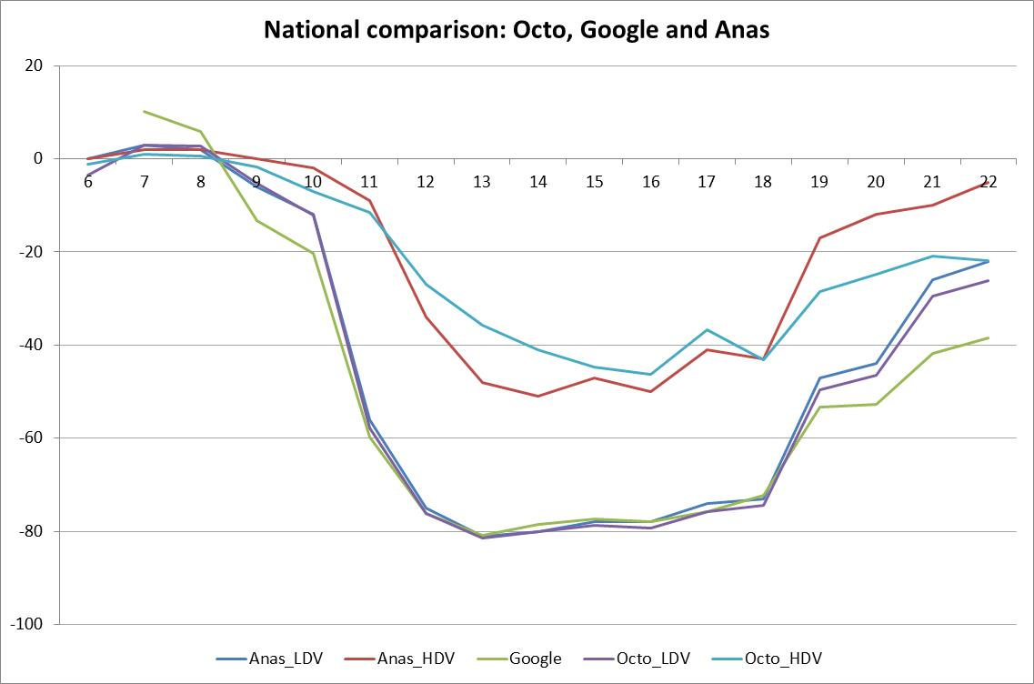
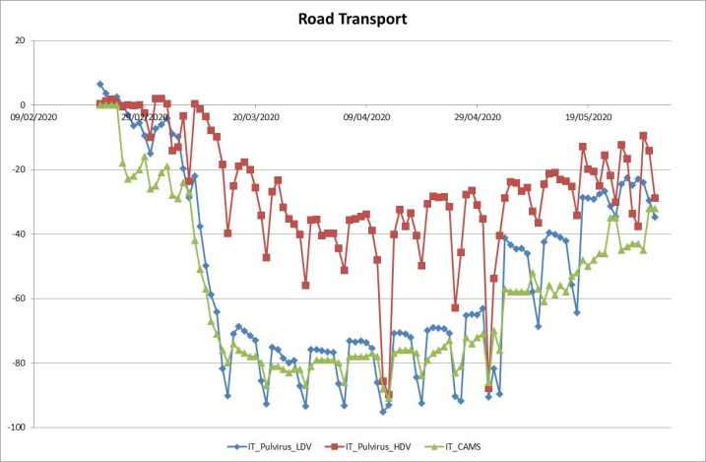
The lockdown emission scenario
Selected adjustment factor variations for each sector
Comparison with regional and European variations
Daily/weekly or monthly profiles

Slide 8
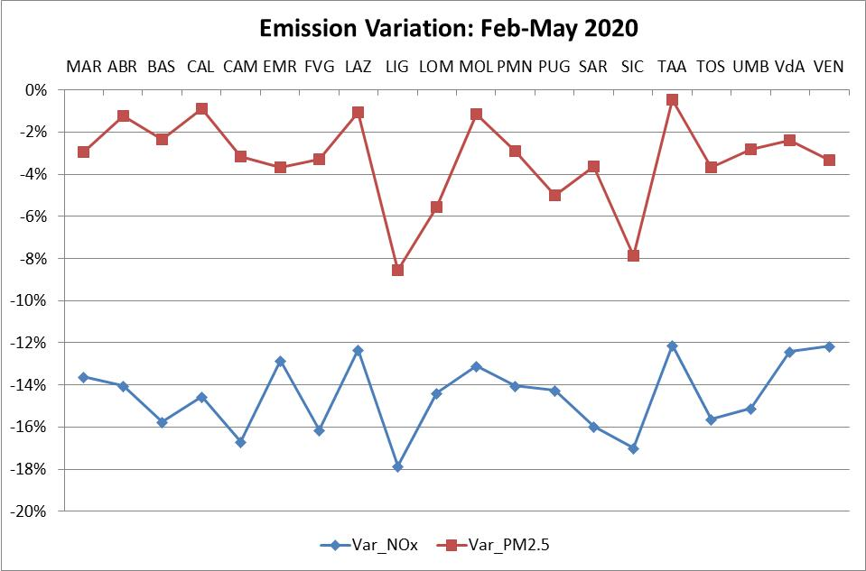
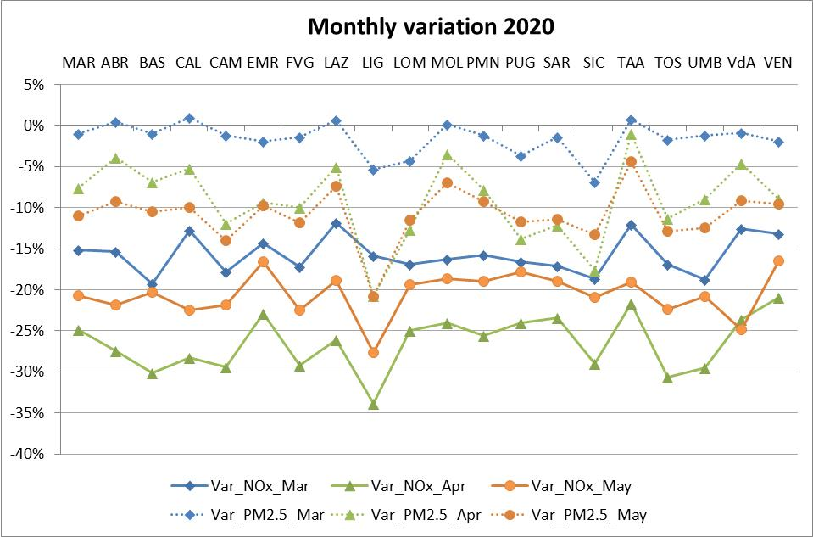
Emission Variations: LOCK vs BASE
In the entire period:
NOx Emission Reductions vary from 12% to 18%;
PM2.5 Emission Reductions vary from 0.5% to 8%
Monthly variations:
NOx highest reductions in April;
In some Regions PM2.5 increases in March

Slide 9
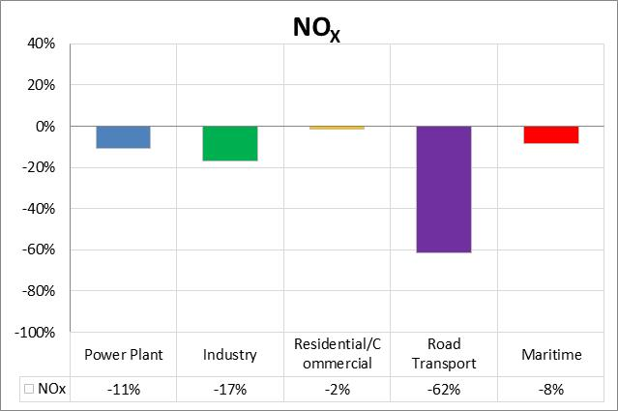
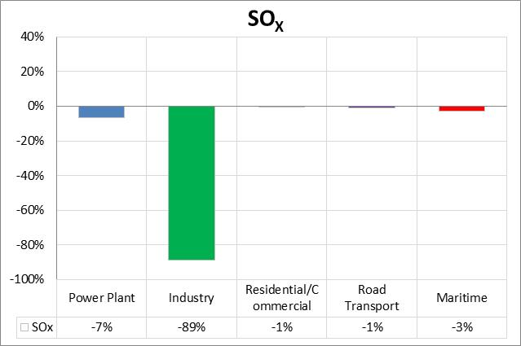
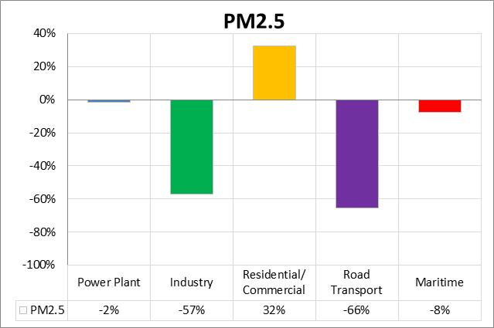
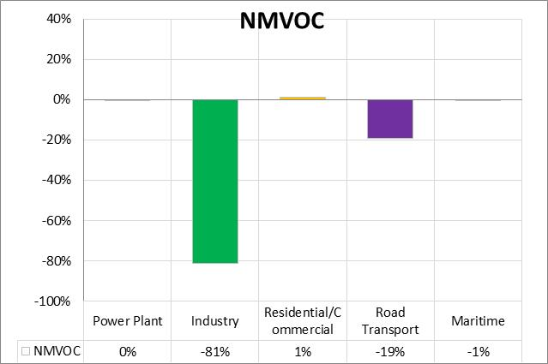
Emission Variations: LOCK vs BASE
Sectoral Contribution, period Feb – May 2020:
- Road Transport: NO_{X} (-60%), PM_{2.5} (-66%)
- Industry: SO_{X} (-90%), NMVOC (-80%);
- Maritime: NO_{X} (-8%), SO_{X} (-3%);
- Residential: PM_{2.5} (+32%);
- No emission variation in the agricultural sector so no significant NH₃ emission reductions.

Slide 10
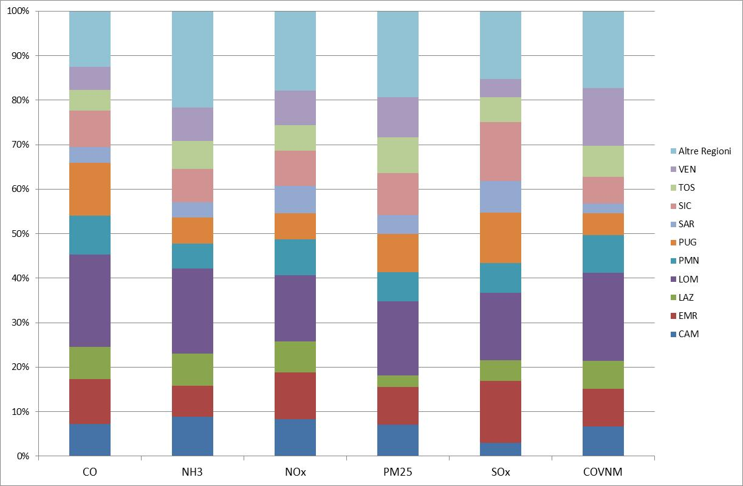
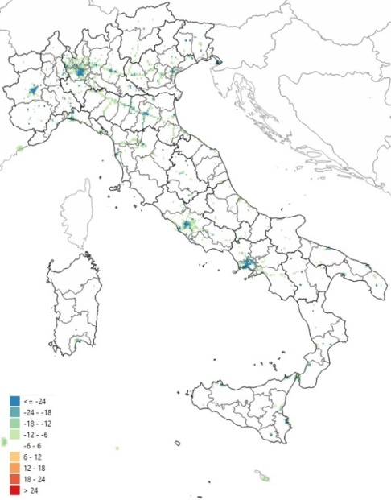
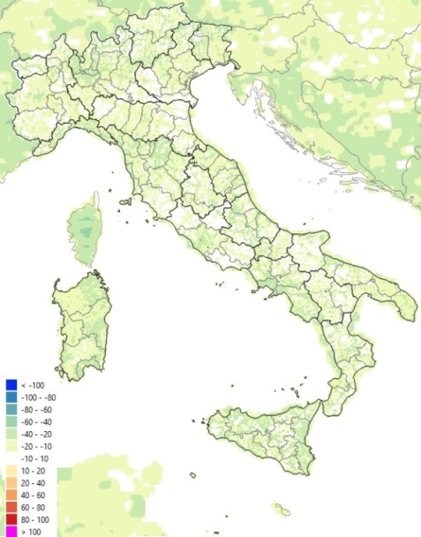
Emission Variations: LOCK vs BASE
NO_{X} Emissions: absolute variation (ton/cell - sx) and % (dx) for the whole period
Lombardy region higher contribution reduction for all the polls (varying form 15% to 21%) then Emilia Romagna.
Maps available for all the pollutants by day, month and for the entire period.

Slide 11
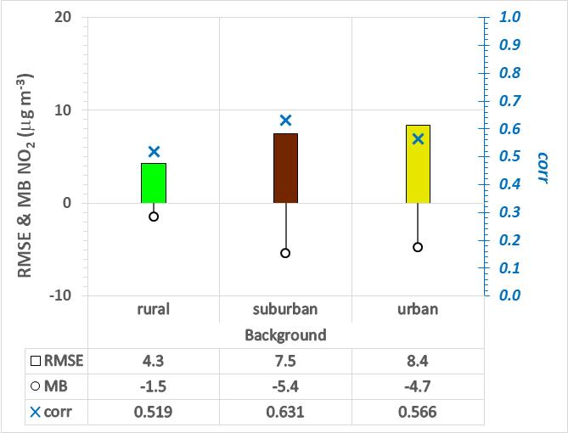
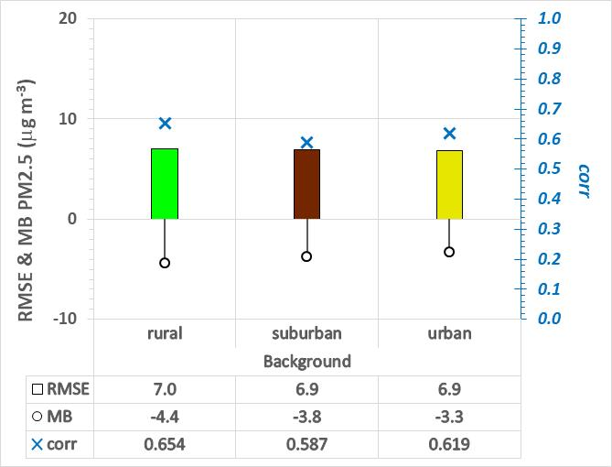
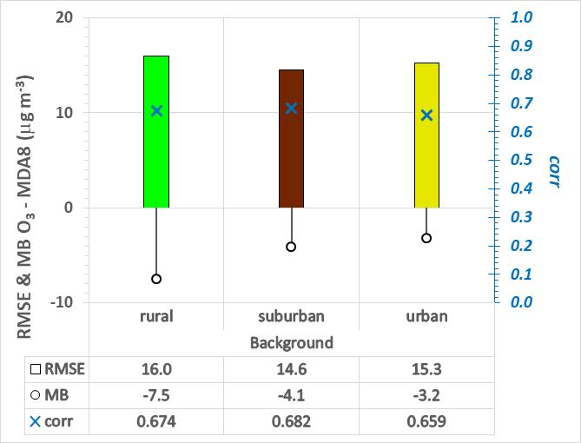
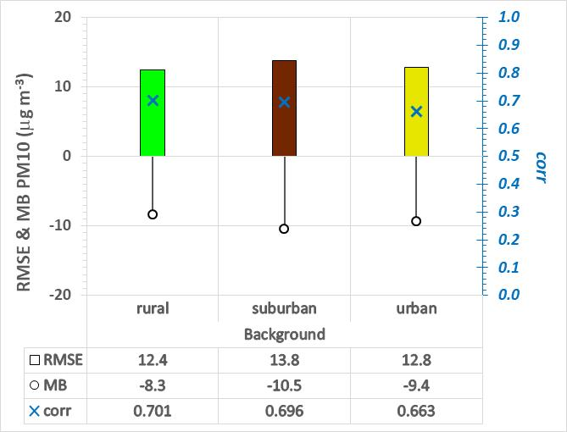
MINNI lockdown and observations
Score calculated in the period Feb – May 2020 for LOCK simulation:
daily values for NO₂ and PM
MDA8 (maximum daily 8-hour average concentration) for O₃
Same model performances of other MINNI simulations
Score calculated for each station, per pollutant, by month and climatic zone.

Slide 12
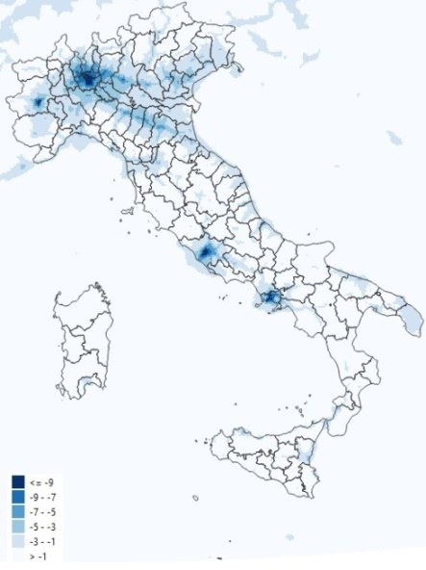
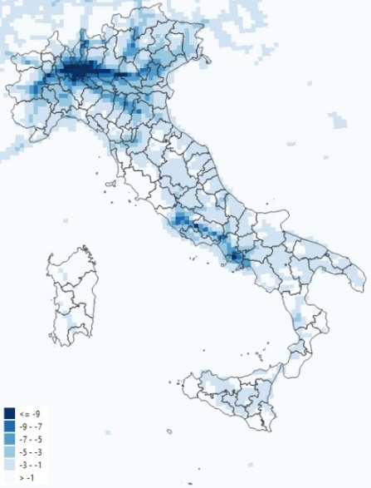
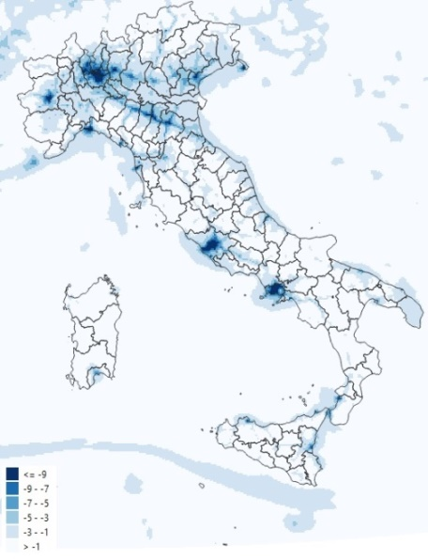
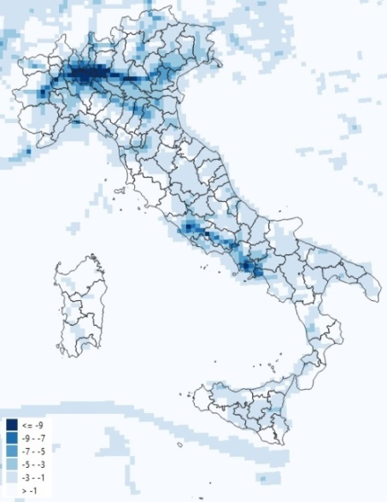
MINNI lockdown and CAMS lockdown: variation in NO₂ concentrations
March 2020
April 2020
MINNI in Pulvirus
(4km)
MINNI in CAMS (10 km)
MINNI in Pulvirus
(4km)
MINNI in CAMS (10 km)

Slide 13
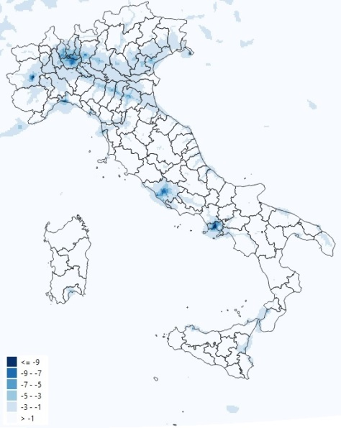
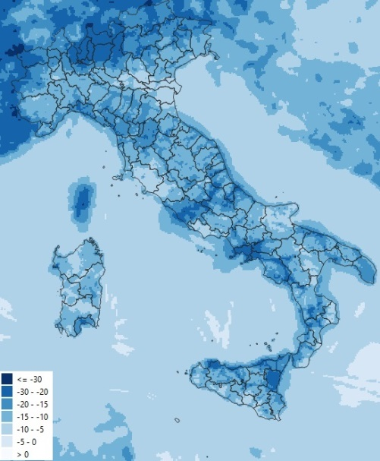
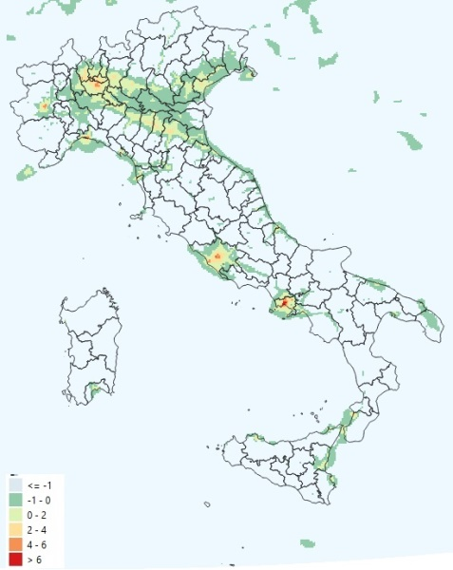
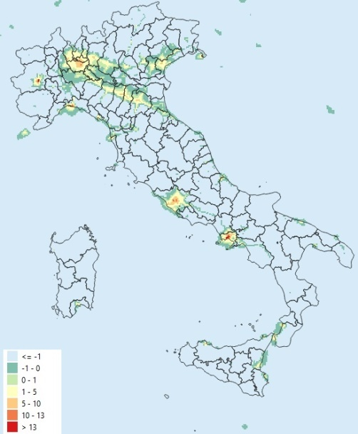
MINNI lockdown: concentration variations – period Feb – May 2020
NO₂
O₃
μg/m³
%
μg/m³
%
In the entire period:
NO₂ concentration reductions vary from 1 to 9 μg/m³ (3% to 30%);
O₃ concentration increases in urban areas till 13% (5-6 μg/m³);
PM does not show significant variations.

Slide 14
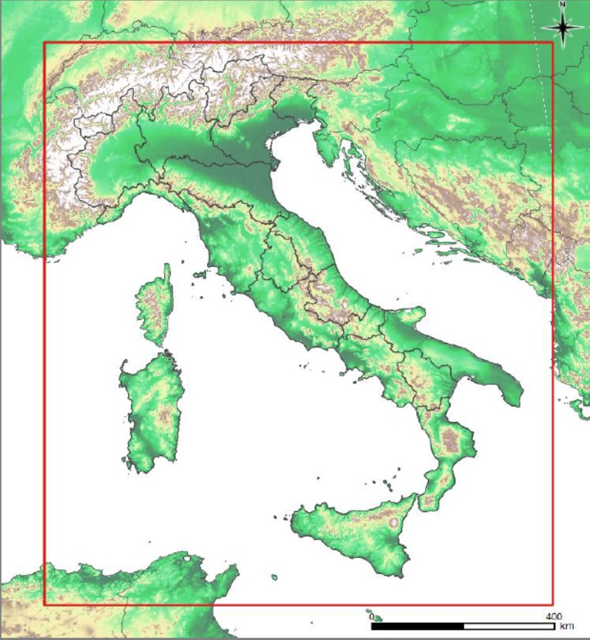
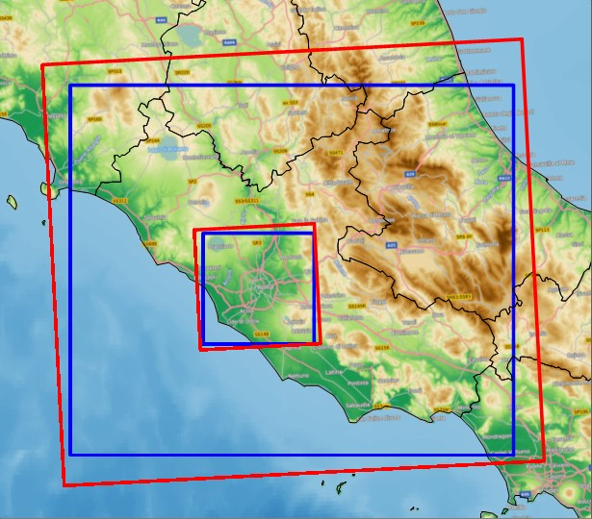
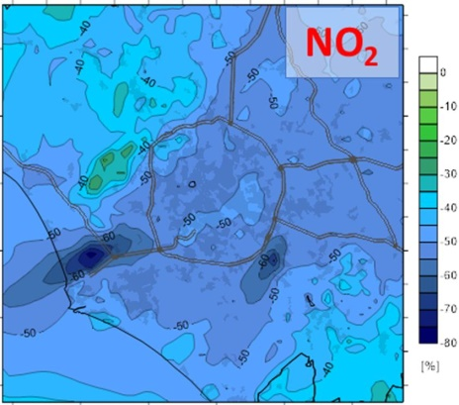
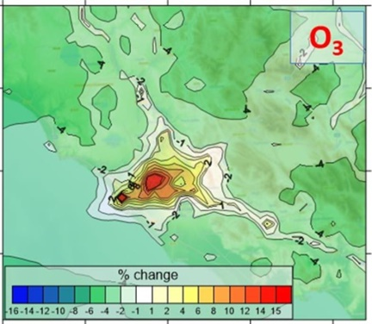
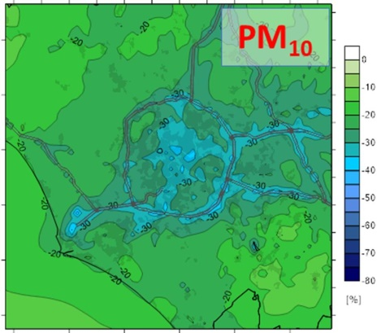
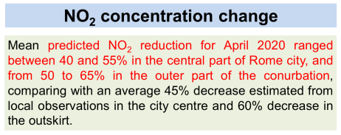
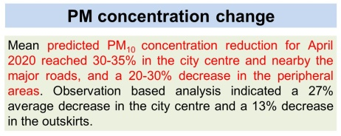
MINNI simulations as BC to other models: Lazio and Rome simulations
PULVIRUS national scale
April 2020 monthly mean concentrations: % reduction due to 2020 vs BASE emissions
Rome 1 km resolution
BCs to Lazio Region
Finardi et al., 2021. GAW Symposium 2021
https://hopin.com/events/gaw-syposium-2021#schedule
Credits by ARIANET e Arpa Lazio.

Slide 15
Evaluation of the impact of reducing emissions on environmental concentrations of greenhouse gases
ENEA manages the Stations for Climate Observation
of Lampedusa and Piano Battaglia (1650 m), both part of the Regional network of Global Atmosphere Watch of WMO:
Lampedusa Station has a series of CO₂ and
other greenhouse gasses data from the 1992.
It is part of the European Research Infrastructure
Integrated Carbon Observation System;
More details on the site and all the installed instruments are available at https://www.lampedusa.enea.it/
Station of Piano Battaglia which has a weekly series of CO₂ data from the 2005.
In the frame of the project PULVIRUS in situ continuous greenhouse / aerosol measurements are strengthened at both the ENEA Stations to answer to the questions: if and to what extent the change in anthropogenic CO₂ emissions associated with the lockdown measures could be reflected in the background atmospheric concentration.

Slide 16
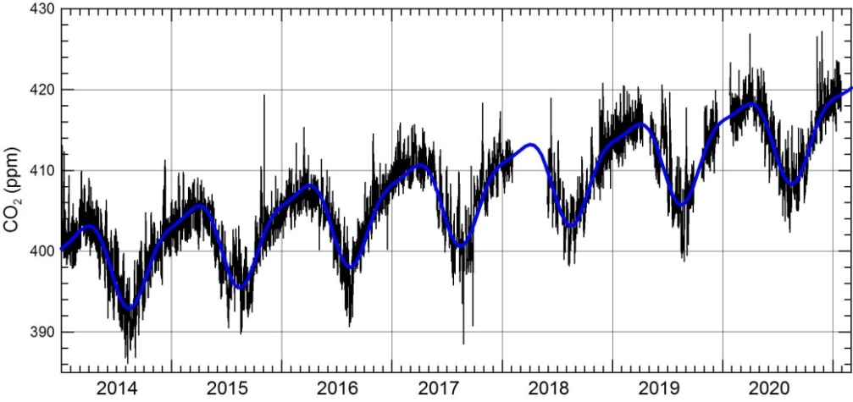
Evaluation of the impact of reducing emissions on environmental concentrations of greenhouse gases
First results:
No CO₂ concentration reductions in Lampedusa site linked to CO₂ emission reductions during the lockdown (estimated on a national level in 9.8% in 2020 respect to 2019);
The CO₂ emission variation rate that should be kept in the next decades to limit global warming to 1.5°C is around 7.5%.
year
Evolution of the hourly concentration of atmospheric CO₂ measured in Lampedusa from 2014 to Feb 2021 (black line; while the blue line is the regression curve that takes into account annual and semiannual cycle).
annual growth of 2.6 ppm / year
amplitude of the annual cycle of 10.5 ppm
amplitude of the semiannual cycle of 3.0 ppm
Contact person: giandomenico.pace@enea.it

Slide 17
Conclusions
In the simulated period (Feb-May 2020) on a national level:
Total NO_{X} emission reductions vary from 12% to 18%;
Total PM_{2.5} emission reductions vary from 0.5% to 8%;
NO₂ concentration reductions vary from 1 to 9 μg/m³, higher in urban areas
O₃ concentration reductions in rural areas and increases in urban areas (to 13%);
PM concentrations (not shown): small variations, more relevant in the Po Valley.
Effects on secondary pollutants and PM composition should be carefully studied.
Reduction measures should be carefully selected: target more sectors (not only mobility, but also agricultural, residential…) and integrate measures on a different scales.
Integrated Approach needed to evaluate the different impacts.
First analyses do not show CO₂ concentration reductions at Lampedusa site.

Slide 18
THANK YOU FOR YOUR ATTENTION
ilaria.delia@enea.it
massimo.disidoro@enea.it

